Slide 1
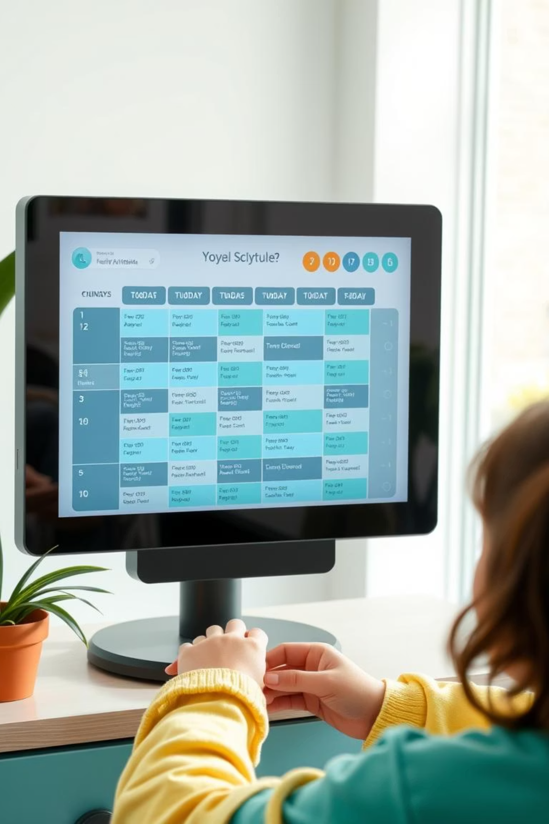









Daily Schedule Planner: Master Your Day!
Welcome to the Daily Schedule Planner, your solution for bringing clarity, control, and efficiency to your daily life. Say goodbye to feeling overwhelmed and hello to a well-structured, productive day.

Slide 2

The Challenge: Overwhelmed by Tasks?
Juggling Multiple Roles
Missed Deadlines
Lack of Clarity
Feeling perpetually behind and missing important deadlines due to poor time management.
Unsure where your time goes, leading to a sense of being overwhelmed and unproductive.
Balancing college, work, personal goals, and essential routines is a constant struggle.

Slide 3
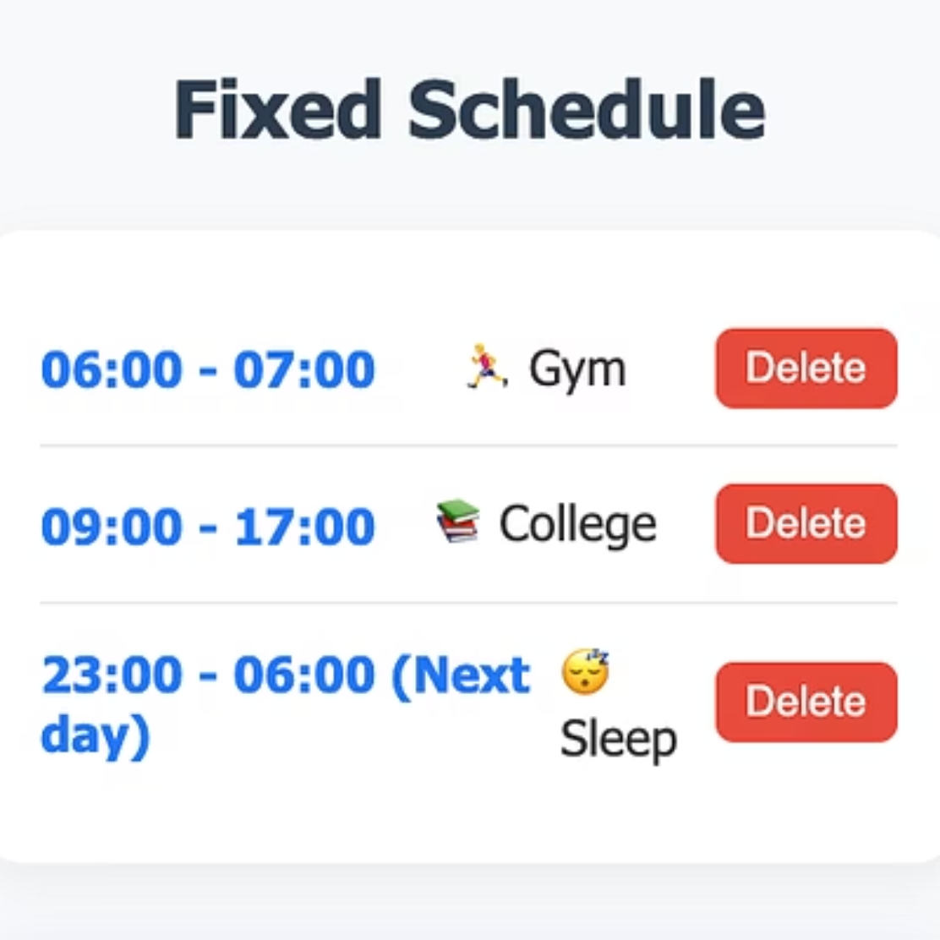
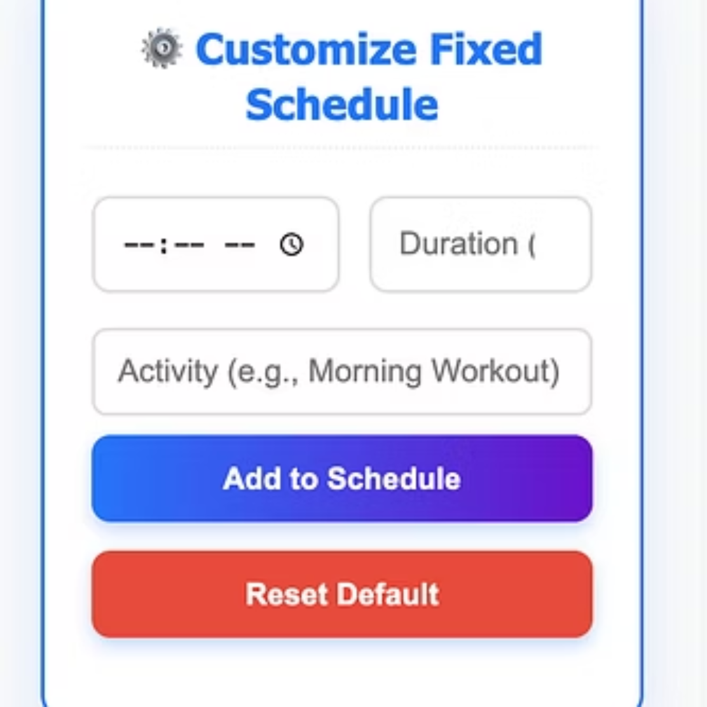
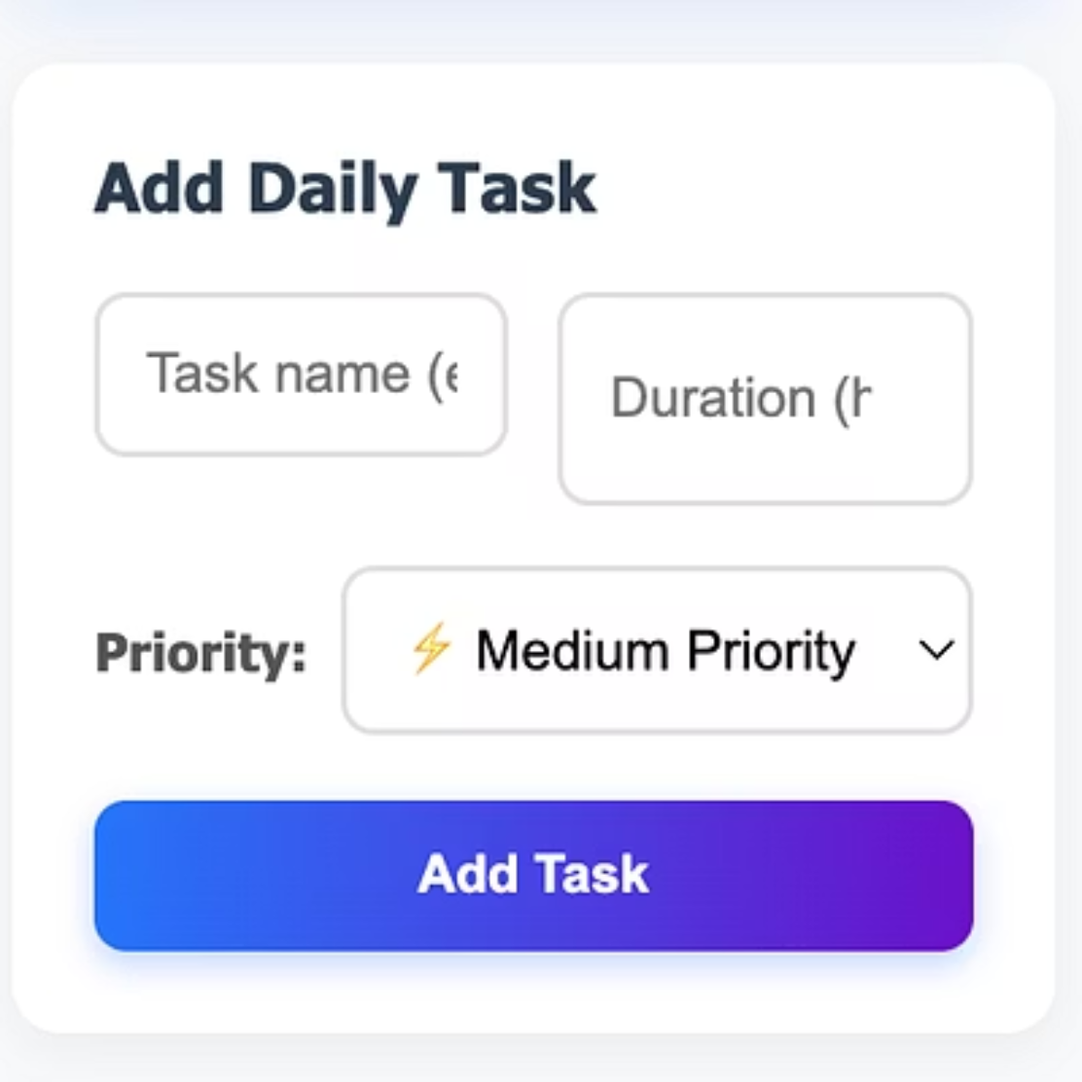

Core Functionality: Building Your Fixed Schedule
Anchor your day with non-negotiable commitments using 'Fixed Schedule' blocks. This creates a clear, unmovable framework for your day, ensuring your most important routines are always accounted for.

Slide 4





Core Functionality: Prioritizing Daily Tasks
List Your Tasks
Assign Priority
Intelligent Allocation
Add all your flexible to-dos, from 'Study Math' to 'Call Mom'.
Crucially, assign each task a priority: High, Medium, or Low.
The planner intelligently slots prioritized tasks into available free time, ensuring critical work is always scheduled first.

Slide 5
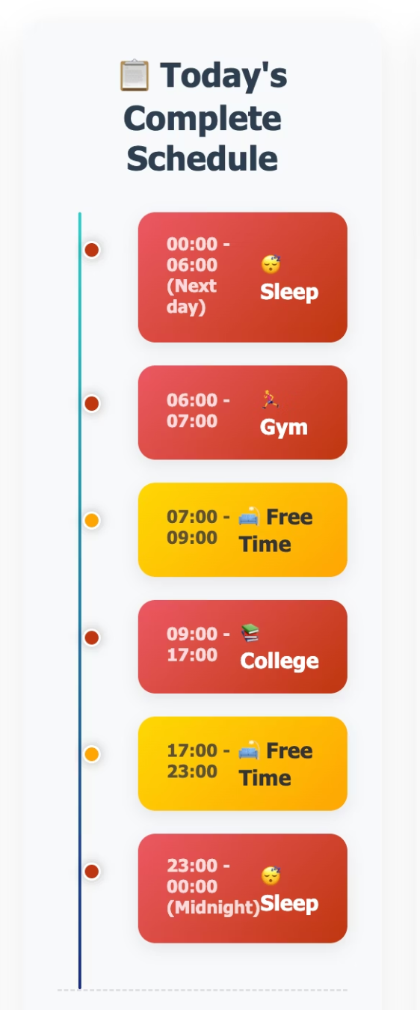



Visual Clarity: Your Complete Schedule Timeline
The 'Today's Complete Schedule' timeline dynamically combines fixed blocks and allocated tasks, offering a clear, minute-by-minute breakdown of your entire day. See when you're busy and, importantly, when you have 'Free Time'.
Easily mark tasks as completed directly on the timeline for satisfying visual feedback and updated productivity stats.

Slide 6






Holistic Well-being & Intuitive Design
Today's Notes
Mood Tracker
Jot down thoughts, ideas, or reminders instantly.
Gauge your feelings for self-reflection.
Productivity Stats
Quick Links
Instant feedback: tasks completed, time spent, productivity percentage.
Integrate frequently used apps for a true daily hub.
The planner boasts a modern, vibrant, and intuitive design with a cool color scheme. It's fully responsive, adapting fluidly to desktop, tablet, or phone for the best experience.

Slide 7

Future Insight: AI-Powered Career Roadmaps
Imagine an AI-powered Career Roadmap Generator within the planner. Tell it your career aspirations, like "I want to be an engineer," and receive a personalized daily roadmap.
Suggests specific practice routines and learning activities.
Engages in a responsive dialogue to refine the roadmap.
Asks questions like, "What genre of music?" or "How many hours can you dedicate?"
Truly tailors the roadmap to your unique goals and circumstances.

Slide 8


Take Control of Your Time
Boost Productivity
Reduce Stress
Achieve Goals
Efficiently manage tasks and commitments.
Gain clarity and control over your daily schedule.
Consistently make progress towards long-term development.
The Daily Schedule Planner empowers you to structure your day, prioritize tasks, and with future AI integration, become an even more powerful tool for personal and career growth.

Slide 9


Thanks for listening!

